Slide 1

Next-Gen Driver Vigilance in Revolutionizing Road Safety
SUBMITTED BY:
HARI OM SINGH- 21BCS8441
VIVEK KUMAR-21BCS8572
HIMANSH RAJPUT-21BCS10625
PRANAB SHARMA-21BCS8942

Slide 2
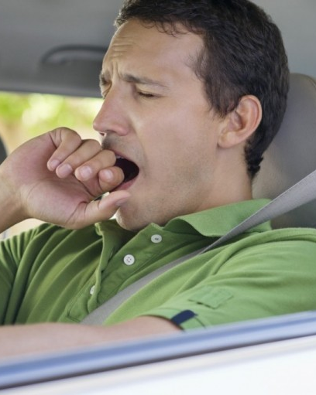

OUTLINE:
Objective
2. Software Requirement
3. Hardware Requirement
4.Role Played
5. Screenshots
6.Future Scope

Slide 3
OBJECTIVE:
Driver drowsiness detection is a car safety technology which helps to save the life of the driver by preventing accidents when the driver is getting drowsy.
Main objective is to continuously monitor the retina of the driver's eye while the vehicle is moving.
To alert the driver by buzzing an alarm when he starts getting drowsy.

Slide 4

SOFTWARE REQUIREMENT:
JUPYTER NOTEBOOK
MACHINE LEARNING
KERAS
TENSORFLOW
WINSOUND
DATASET

Slide 5
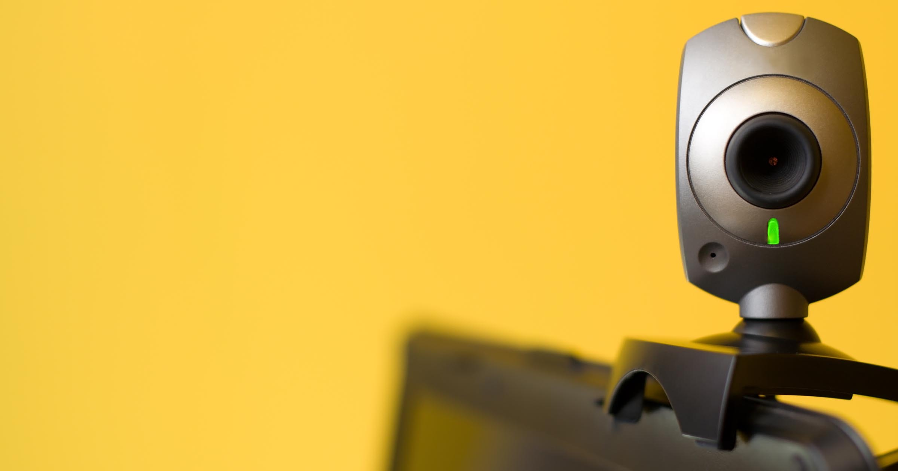
HARDWARE REQUIREMENT:
WEB CAMERA

Slide 6
ROLE PLAYED:
Collected data set required for the project from online sources.
Sorted the data into training data and testing data, further divided data into opened eyes and closed eyes.
Created model and trained the model based on collected data.
Created main program to detect face and eyes.
Created beep sound when eyes are closed.

Slide 7
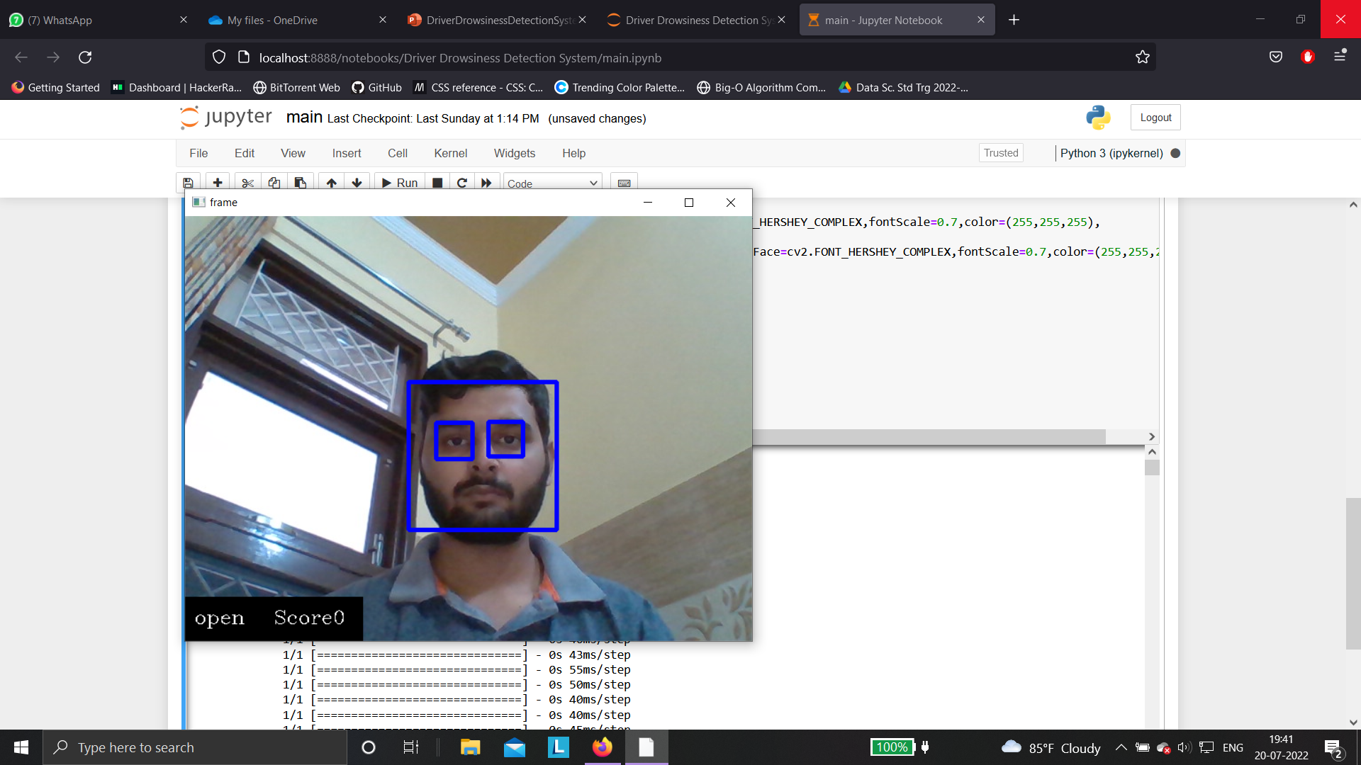
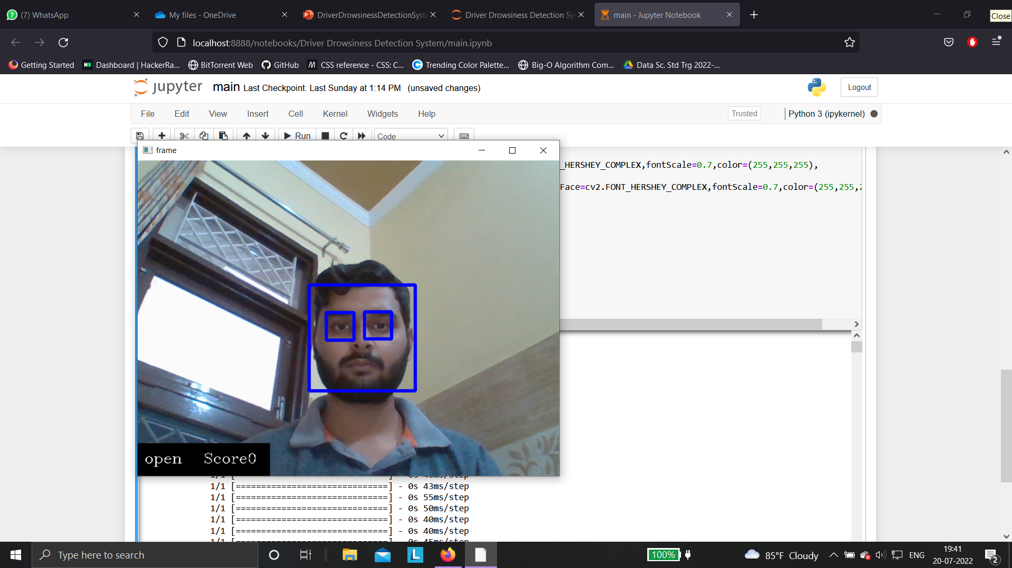
SCREENSHOTS:
OPENED EYES:

Slide 8
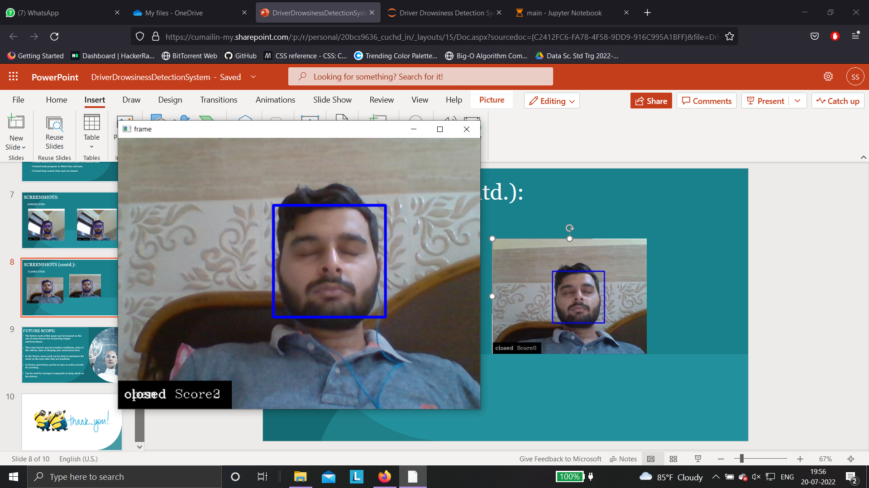
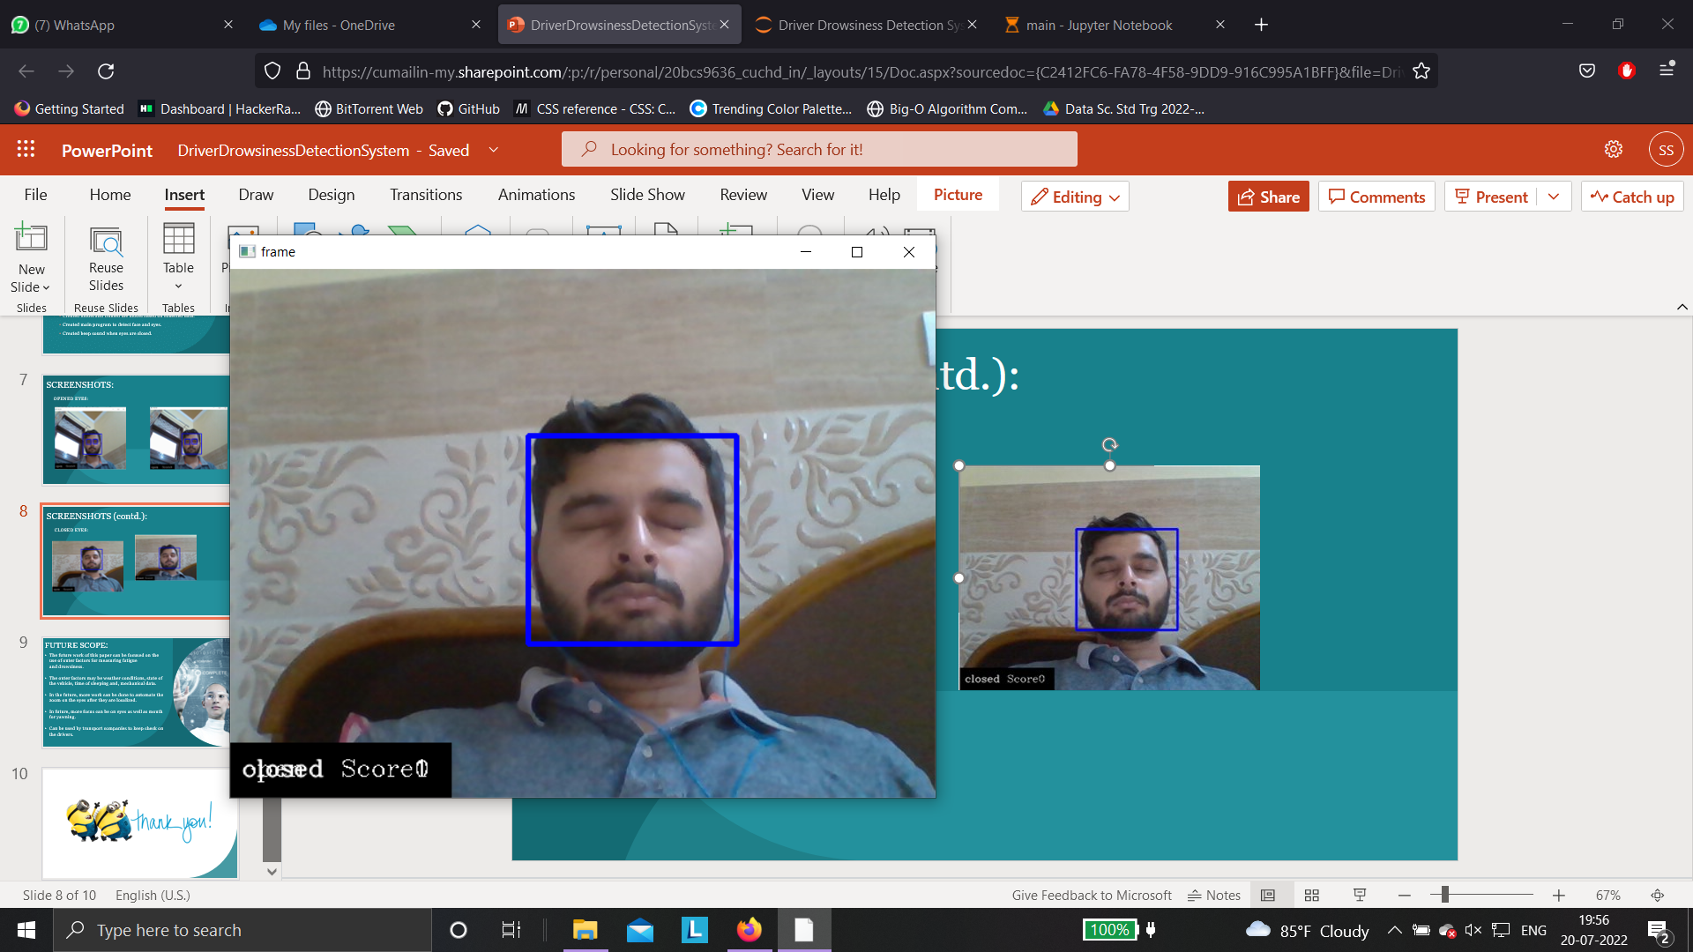
SCREENSHOTS (contd.):
CLOSED EYES:

Slide 9

FUTURE SCOPE:
The future work of this paper can be focused on the use of outer factors for measuring fatigue and drowsiness.
The outer factors may be weather conditions, state of the vehicle, time of sleeping and, mechanical data.
In the future, more work can be done to automate the zoom on the eyes after they are localized.
In future, more focus can be on eyes as well as mouth for yawning.
Can be used by transport companies to keep check on the drivers.

Slide 10


